Slide 1

New Approximation Algorithm for Graph Coloring problem
(GREEDY HEURISTICS AND DIVIDE & CONQUER STRATEGY)
Presented By: TARACHAN RANA [21CSB0B58] SUNNY KUMAR [21CSB0B56] UJJWAL KUMAR SINGH [21CSB0B61]
Under the Guidance of: Dr Manish Kumar Bajpai
Associate Professor, Dept of CSE , NIT Warangal.

Slide 2
PROBLEM STATEMENT:​
GRAPH COLORING PROBLEM:
Vertex Set and Edge Set:
Vertex set V(G) of a simple graph G is {v1, v2, …, vn}
Edge set E(G) is {e1, e2, …, em}, with each edge ek mapped to a pair of disordered end vertices (vj, vi).
Graph Coloring Problem (GCP):
Minimum number of colors required to color V(G) such that adjacent vertices are assigned different colors is denoted as χ(G) and referred to as the graph coloring problem (GCP).

Slide 3
Class of hardness:
GCP is a NP-Hard Problem (Proof By Local Replacement Method)
Independent Set Problem
Graph Coloring Problem
Dynamic S = {s1, s2, s3, s4, s5, s6, ..., sn}
Graph Representation G: Consists of vertices V = {v1, v2, v3, ..., vn}
Vertex Mapping: S1 maps to V1 = {v1, v2, v9} S2 maps to V2 = {v3, v4, v8} S3 maps to V3 = {v14}
Independent Subsets: S1 = {s1, s2, s9} S2 = {s3, s4, s8} S3 = {s14}
Si
Vi

Slide 4
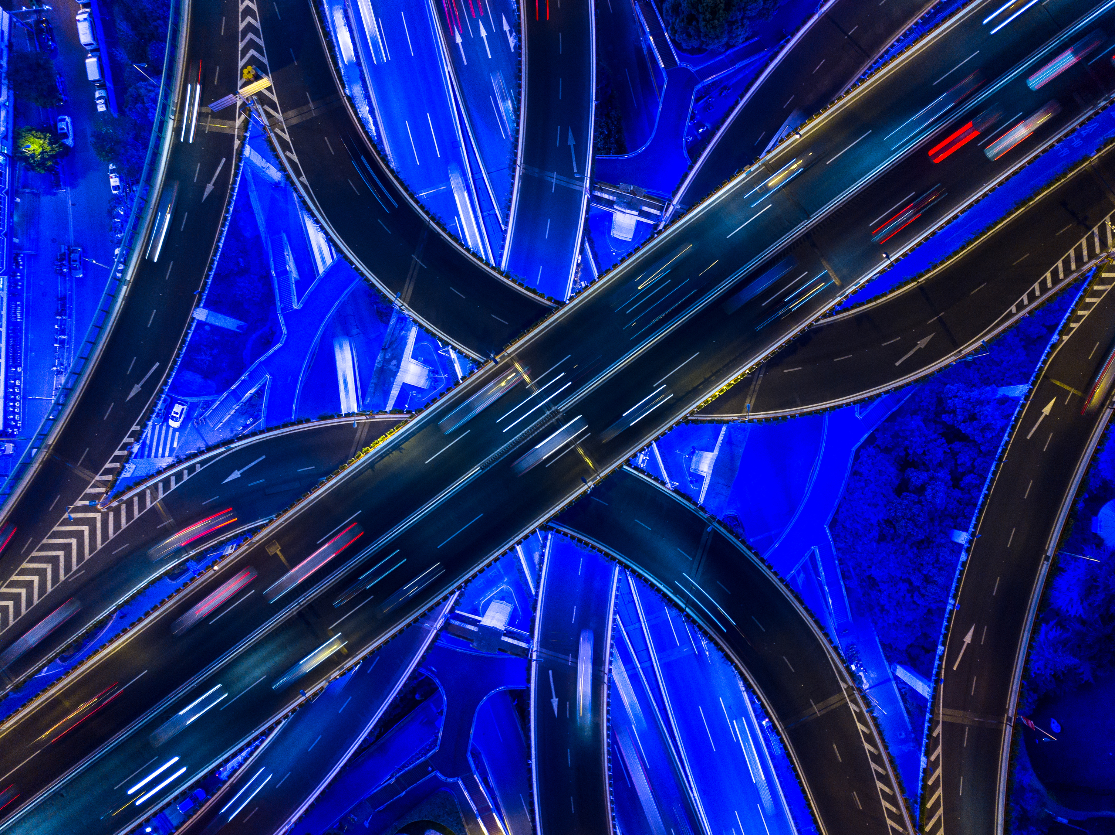
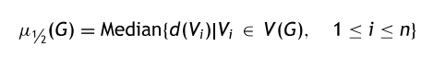
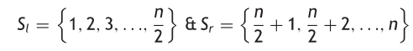
Proposed solution:
Notions, variables, data structures and procedures:
Median degree μ_{½}(G): The degree d(vi) of vi is the number of ej's incident onto vi. mincolor: A variable to store a possible minimum integer value. color[]: color[i] will hold the color value of the ith vertex. SetGreedyColor(i): A procedure which sets a color to vertex i. Conflicting vertices: Two adjacent vertices i and j are said to be conflicting iff color[i] = color[j]. Conflict function f(G): This function assigns the total number of conflicting vertices in V(G). Split (S): Set S = {1, 2, 3, …, n} is split into two subsets Sl and Sr

Slide 5
M1:Greedy and heuristics:​
The iterative method is a product of the evolution from the greedy design strategy with heuristics. It is initialized with mincolor as 3 and color[i] = 0 for 1 ≤ i ≤ n.
Case 1: SetGreedyColor(i)
A heuristic procedure is executed on all vertices whose degree ≥μ_{½} (G), employing a greedy approach as follows:
Choose a vertex i such that color[i] = 0 and degree (i) ≥ μ_{½} (G).
For j = 1 to mincolor:
Boolean t = false;
For k = 1 to n:
If (Aik = 1), then:
If (color[k] = = j), then t = false; break;
Else t = true;
If (t = true), then color[i] = j; break;
Repeat Steps i and ii for other vertices whose degree ≥μ½ (G).
Case 2:
For all the vertices whose degree <μ½ (G), SetGreedyColor (i) is invoked. Compute f(G). If f(G) ≠ 0, set mincolor = mincolor + 1; repeat case 1 and case 2 until f(G) = 0. This greedy procedure assigns color[i] in [1,mincolor] for all 1 ≤ i ≤ n.

Slide 6
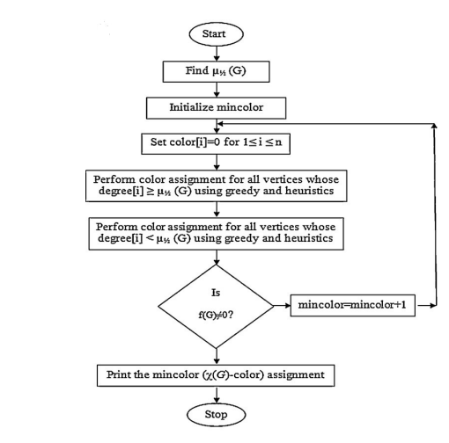
Flow chart
Introduction
Building confidence
Engaging the audience
Visual aids
Final tips & takeaways

Slide 7
M2: divide and conquer strategy
This iterative method is evolved by applying the divide & conquer strategy in method 1; by initializing mincolor as 3 and color[i] = 0 for 1 ≤ i ≤ n.
Call Split(V(G)) to partition V(G) into Vl(G) and Vr(G).
If n > 100:
- Call Split(Vl(G)) to partition Vl(G) into Vll(G) and Vlr(G).
- Call Split(Vr(G)) to partition Vr(G) into Vrl(G) and Vrr(G).
Calculate the number of conflicting edges from Vl(G) to Vr(G) and
from Vr(G) to Vl(G).
Resolve (Vl(G), Vr(G)) and (Vlr(G), Vrr(G)) in concurrence using method 1, addressing the subset with more conflicting edges first.
Compute f(G). If f(G) ≠ 0 or color[i] > mincolor for all i in [1, n], set mincolor = mincolor + 1 and repeat steps 3 and 4 until f(G) = 0.

Slide 8
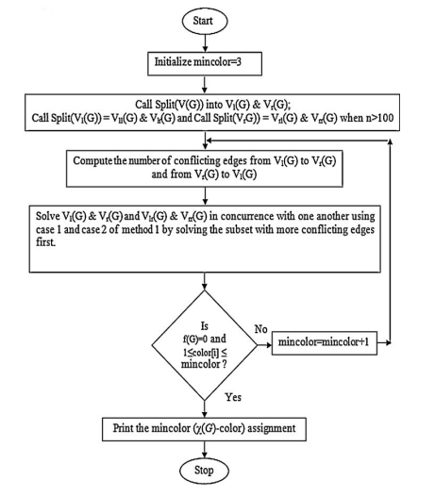
Flowchart

Slide 9
TIME COMPLEXITY ANALYSIS:
Best Case Time Complexity:
The best-case scenario occurs when the graph can be evenly divided into subsets with balanced colors and minimal conflicts, resulting in a time complexity closer to O(V log V) .
This arises when the recursive division efficiently balances the subsets, leading to a more efficient coloring process with minimal conflict resolution needs.
Worst Case Time Complexity:
The worst-case scenario occurs when the graph divisions lead to unbalanced subsets with high conflict resolution needs, resulting in a time complexity approaching O(V^2) .
This worst-case complexity emerges when the graph division strategy and conflict resolution mechanisms require extensive adjustments and re-coloring to resolve conflicts, leading to a significantly higher time complexity.

Slide 10
Results obtained:
For a Graph with G(V,E) with n=|V| ,where n<=100; we have the following outputs: 1.Output-1 from the Online Graph Simulation Website : graphsonline.ru 2.Output-2 from the Greedy Heuristics Method
No. of Vertices(|V|) | No. of Edges (|E|) | Output -1(No of Colors) | Output-2 (No of Colors)
10 | 9 | 3 | 3
10 | 21 | 4 | 4
15 | 15 | 3 | 3
15 | 42 | 4 | 4
25 | 142 | 7 | 6
40 | 224 | 6 | 6
50 | 227 | 6 | 6
75 | 573 | 7 | 7
95 | 931 | 8 | 8

Slide 11
Results obtained:
For a Graph with G(V,E) with n=|V| ,where n>100; we have the following outputs: 1.Output from the Greedy Heuristics Method and Divide and Conquer Strategy:
No. of Vertices(|V|) | No. of Edges (|E|) | No. of Colors (OutPut)
101 | 1048 | 6
125 | 798 | 5
250 | 3193 | 6
350 | 6251 | 7
500 | 6227 | 4
1500 | 11248 | 4

Slide 12
Why this algorithm?
The devised methods are evaluated using benchmark graphs and near optimal solution are obtained; and optimal solution is obtained for most of the graphs. The divide & conquer strategy is performed well for most graphs compared to method 1.
Leveraging innovative integration of divide and conquer strategy and greedy heuristics
Aimed at efficient and accurate vertex coloring in graphs
Specific focus on large or complex graphs
Optimization of coloring process by minimizing conflicts and reducing the number of required colors
Promise of enhanced scalability and effectiveness for diverse graph structures and characteristics

Slide 13
Limitations and point of improvements?
Sensitivity to Initial Partitioning: The algorithm's performance is highly reliant on the initial division of the graph, potentially leading to suboptimal colorings if the subsets are unbalanced.
Suboptimal Solutions in Worst Cases:
In scenarios with high conflicts, the algorithm may produce colorings significantly deviating from the optimal solution, leading to inefficient results.
Dependence on Graph Characteristics: The algorithm's effectiveness varies based on specific graph properties, impacting the quality of the produced colorings.
Scalability Concerns: Limited scalability for large graphs due to potential high time complexity, affecting its practical utility for extensive graph coloring tasks.

Slide 14
THANK YOU

